Slide 1
Department of Child Safety Weekly Data Charts
Data as of week beginning: 9/5/2022

Slide 2
Total Agency Staff
Note: Chart is updated bi-monthly. Current month data is preliminary.
Data Source: Director’s Monthly Staff Chart, 9/7/2022
Data Owner: Limni Varela, HR Team

Slide 3
Agency Turnover and Separation
Note: Chart updated monthly.
Data Source: DCS Monthly Staffing Report, 9/7/2022
Data Owner: Limni Varela, HR Team

Slide 4
Workforce Resilience
Chart is updated monthly.
Data Source: Workforce Resilience Volunteer Hours Tracking Log, 9/6/2022
Data Owner: Lyn Hart

Slide 5
Communications & Reports to the Hotline by date Intake received
Note: Period reported is based on Intake call date/time. Data refreshed Feb 2021-date. All counts include finalized Intakes. Intake report counts include all dispositions (no jurisdiction, QA review, Action Taken, Field Investigation, null). Screen In % shows reports as a percentage of total Hotline Communications.
Data Source 1/1/2021 – 9/5/2022: Guardian Advance Find extract.
Data Owner: Ryan Clemens

Slide 6
Completed Reports vs. Assigned New Report
Note: Updates to Jan-Sept data resulted in a decrease in closed reports due to Assessments re-opened to complete required process/data entry. Counts exclude Intake reports with disposition of no jurisdiction, QA review and action taken.
Data Source 1/1/2021 – 9/6/2022: Guardian Advance Find extract. New Intake report period is based on Intake Finalization Date. Closed Reports is based on Assessment End Date.
Data Owner: Ryan Clemens

Slide 7
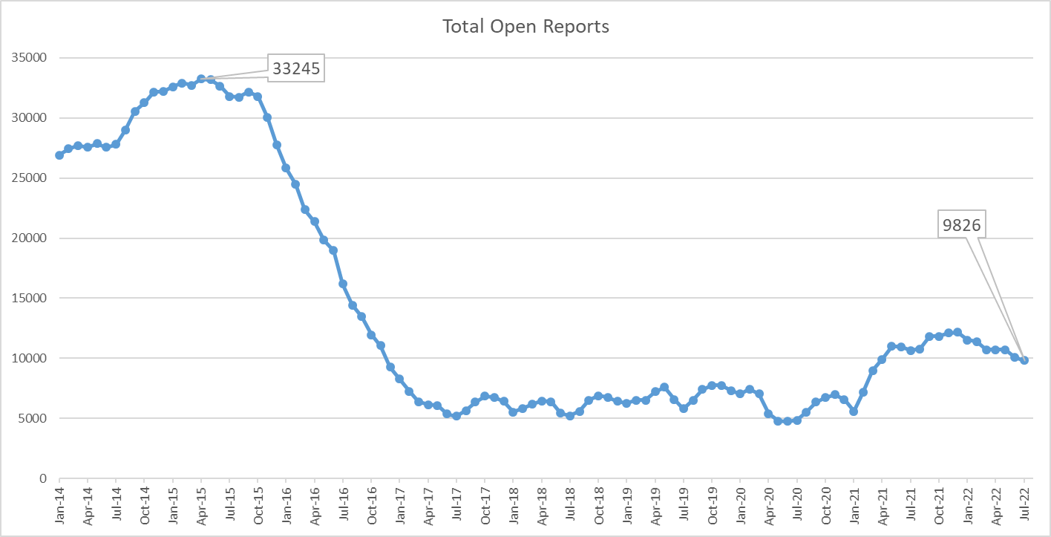
Total Open Reports
NOTE: Investigations may contain one or more reports. Current open reports is through 7.11.22
Data Source: CHILDS 1.28.21; Guardian 2.1.21 to current

Slide 8
Entries & Exits
Notes:
1. Counts exclude entries added in error.
2. Counts include removal entries in Guardian without the child’s name - this issue has been resolved and is being monitored
3. Comprehensive data validation is still in process. Currently estimating ~5% error margin on removals with removal date after Feb 1, 2021.
Data Source as of 9/5/2022: Guardian Advance Find extract.
Data Owner: Ryan Clemens

Slide 9
Children Receiving In Home Services Children with Case Plan Goal – Remain with Family
NOTE: Mar - July 2022 updated to capture lagging data and continuous data quality improvements. Guardian data report criteria includes: Case =Open, Child is active person in case with role of child, Child is not removed, Case Plan status is draft, or is finalized with Effective date on or before last day of report month, or is expired up to 120 days if there is not a current or draft plan, most recent Permanency Goal (including drafts) = Remain with Family. Criteria for chart displaying No Case Plan: Case = Open, Child is active person in case with role of child, Child is not removed, case plan does not contain data or does not contain a permanency goal.
Data Source: Guardian CE Extract; Data as of 9/62022
Data Owner: Leanne Hawkins

Slide 10
Children in Out-of-Home Care (0-17 years old)
NOTE: Mar-Aug 2022 updated to capture lagging data and continuous data quality improvements. Other category includes Runaway, Missing/Abducted & No Placement Entry (placement not yet entered or date is misaligned). Data includes: Child removal date is <= report period end date, return date is null or > than report period end date, most recent caregiver date entered on Guardian Placement table is >= removal date, caregiver end date is null or > report period end date. Estimated margins of error in distribution of caregiver categories is ~4-8% since Jan 2021.
Data Source: CE Advance Find exports; data updated 9/6/2022
Data Owner: Leanne Hawkins

Slide 11
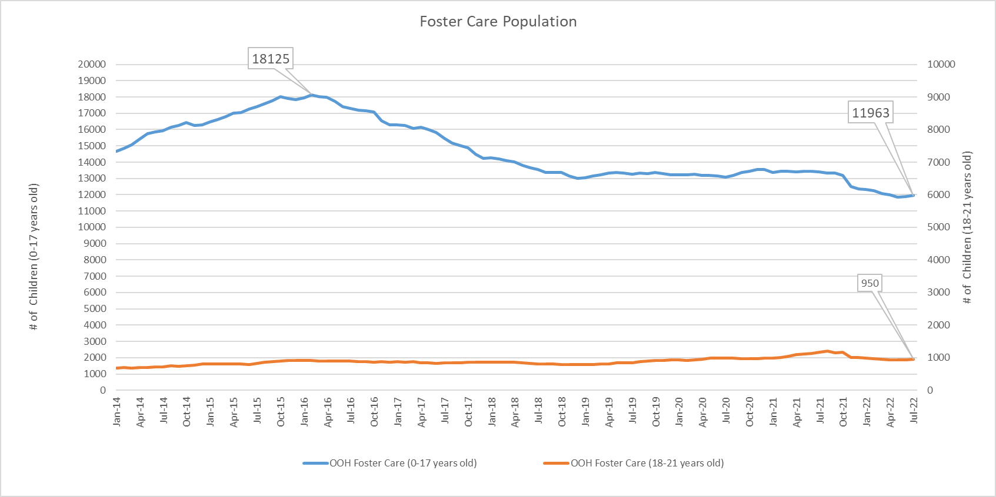
O-O-H Care Management Population
NOTE: Current OOH population through 7.11.22
Data Source: CHILDS through 1.28.21; Guardian 2.1.21 to current

Slide 12
Runaway Youth
NOTE: Mar-Aug 2022 updated to capture lagging data and continuous data quality improvements. Data inclusions: Child removal date is <= report period end date, return date is null or > than report period end date, most recent caregiver date entered on Guardian Placement table is >= removal date, caregiver end date is null or > report period end date. Estimated margins of error in distribution of caregiver categories is ~4-8% since Jan 2021.
Data Source through 12/31/2020: AMPM - OOH Statewide; 1/1/2021-9/6/2022: CE Advance Find exports
Data Owner: Leanne Hawkins

Slide 13
Children Missing/Abducted
NOTE: Mar-Aug 2022 updated to capture lagging data and continuous data quality improvements. Data inclusions: Child removal date is <= report period end date, return date is null or > than report period end date, most recent caregiver date entered on Guardian Placement table is >= removal date, caregiver end date is null or > report period end date. Estimated margins of error in distribution of caregiver categories which includes children Missing/Abducted is ~4-8% since Jan 2021.
Data Source through 12/31/2020: AMPM - OOH Statewide; 1/1/2021-9/6/2022: CE Advance Find exports
Data Owner: Leanne Hawkins

Slide 14
Children Age 0 -17 in Congregate Care
NOTE: Mar-Aug 2022 updated to capture lagging data and continuous data quality improvements. Data inclusions - Child removal date is <= report period end date, return date is null or > than report period end date, most recent caregiver date entered on Guardian Placement table is >= removal date, caregiver end date is null or > report period end date. Estimated margins of error in distribution of all caregiver categories is ~4-8% since Jan 2021. Margins of error in distribution of Shelter and Other Congregate Care buckets is higher – root cause analysis was performed and a solution is in process.
Data Source 1/1/2021-9/6/2022: CE Advance Find exports
Data Owner: Leanne Hawkins

Slide 15
Young People in Extended Foster Care (18-21 years old)
NOTE: Mar-Aug 2022 updated to capture lagging data and continuous data quality improvements. Other category includes Runaway, Missing/Abducted & No Placement Entry (placement not yet entered or date is misaligned). Data inclusions: Child removal date is <= report period end date, return date is null or > than report period end date, most recent caregiver date entered on Guardian Placement table is >= removal date, caregiver end date is null or > report period end date. Estimated 6-12% margin of error in distribution of caregiver categories since Jan 2021.
Data Source 1/1/2021-9/6/2022: CE Advance Find exports
Data Owner: Leanne Hawkins

